Slide 1
Assignment 4 News Sentiment Analysis
Group Members: Muskan Sharma(200596320)
Selvi NileshKumar Patel(200590923)

Slide 2

Introduction to the topic
News sentiment analysis is the process of applying Natural Language Processing (NLP) techniques to identify the emotional tone behind news articles or headlines. It helps determine whether the content conveys a positive, negative, or neutral sentiment.
Why is it important?
Market Impact: News sentiment strongly influences stock prices and economic trends.
Decision-Making: Investors, businesses, and policymakers use sentiment analysis for risk assessment.
Automation: Saves time by analyzing large volumes of news data efficiently.
Dataset Used
Source: Kaggle - News Sentiment Analysis Dataset
Contains news headlines with sentiment labels (Positive, Negative, Neutral).

Slide 3
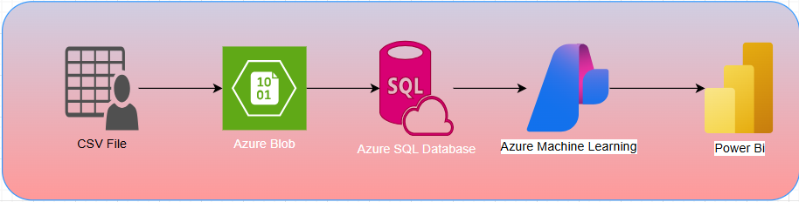
News Sentiment Analysis – Data Flow
CSV File: Raw news data source.
Azure Blob Storage: Stores uploaded CSV securely.
Azure SQL Database: Structured storage for easy querying.
Azure Machine Learning: Trains and applies sentiment analysis model.
Power BI: Visualizes sentiment insights in interactive dashboards.

Slide 4
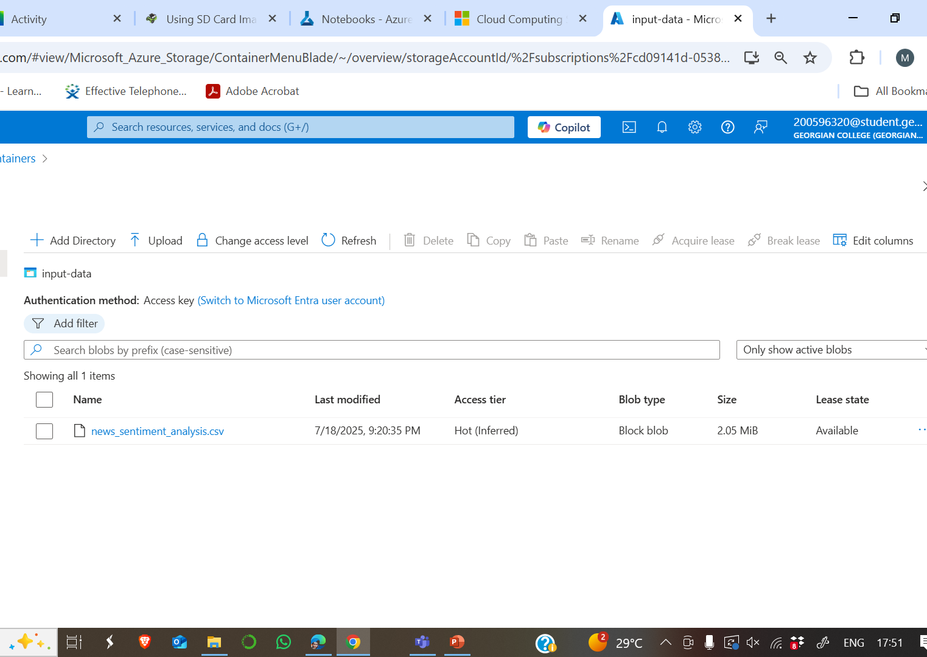
Step 1: Uploading CSV File to Azure Blob Storage
Process:
Logged into Azure Portal and created a Storage Account named ‘storageaccountmuskan’
Created a Blob Container named ‘input-data’ inside the storage account.
Uploaded the raw CSV file (news dataset) into the Blob container.
Why: Azure Blob acts as a scalable and secure data lake for unstructured data.

Slide 5
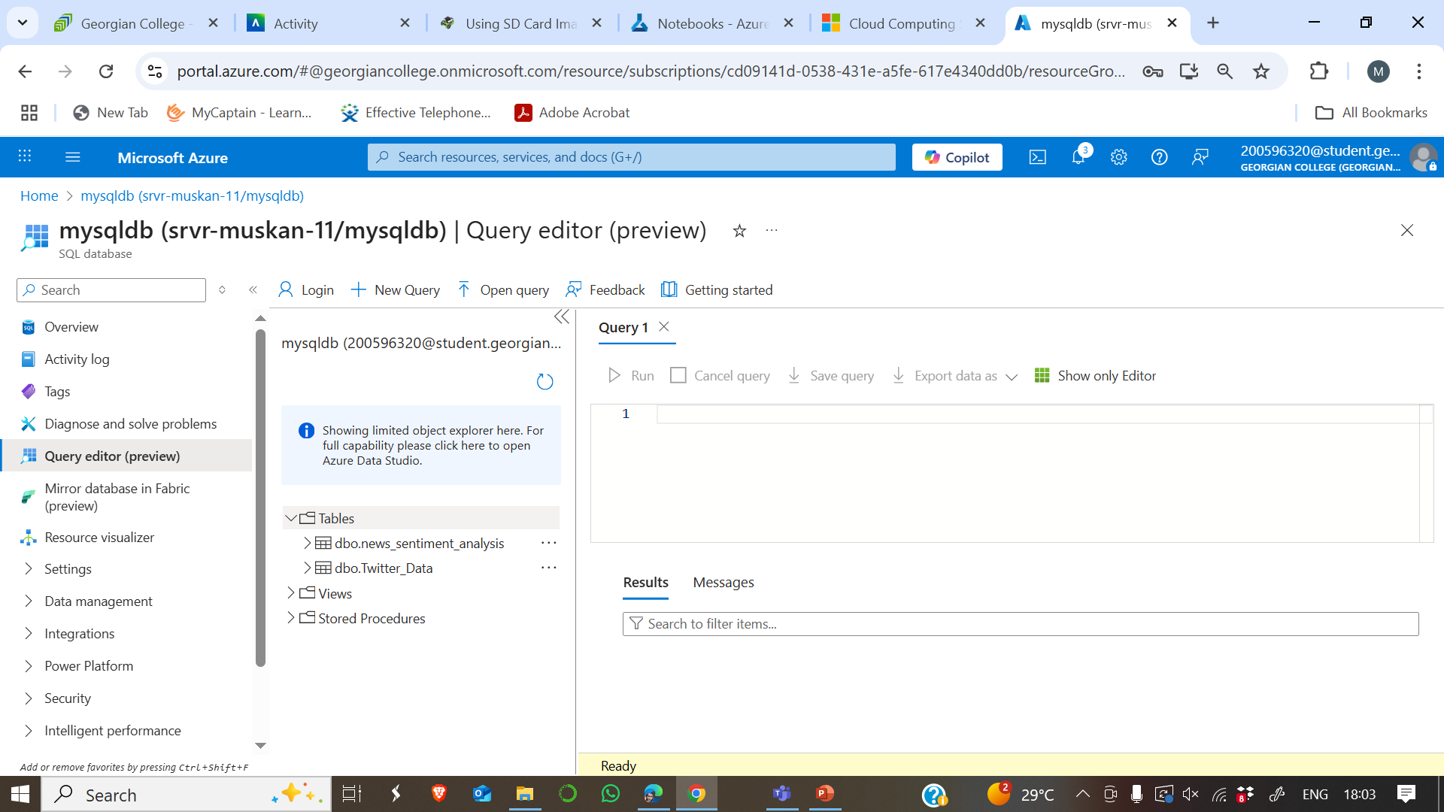
Step 2: Transferring Data from Azure Blob to Azure SQL Database
Process:
Created an Azure SQL Database and set up a SQL Server in Azure.
Used Azure Data Factory (ADF) pipeline to move data:
Source: Azure Blob Storage (CSV file).
Sink: Azure SQL Database (table).
Defined a Mapping Data Flow in ADF for schema mapping.
.

Slide 6
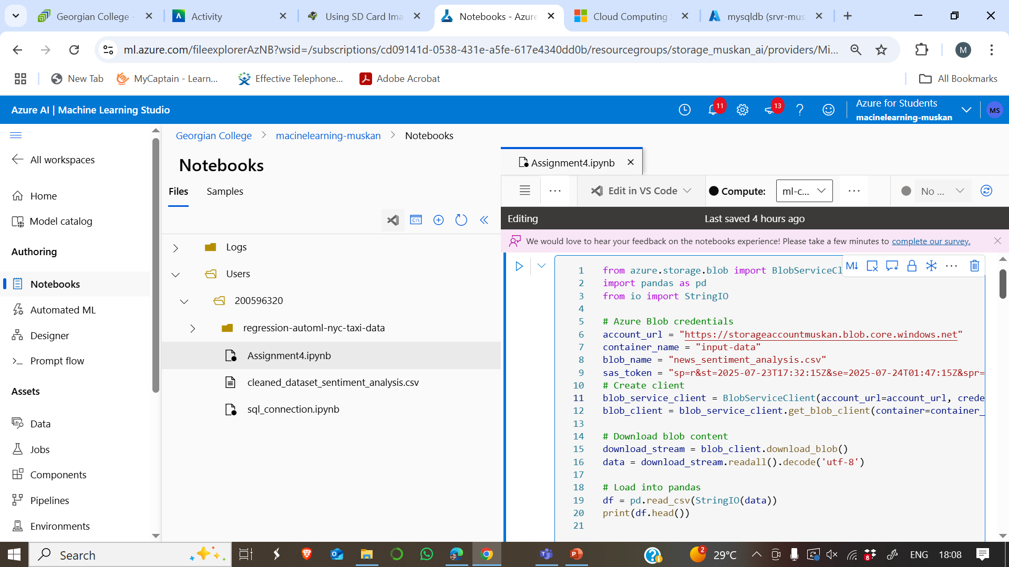
Step 3- Ingesting Data in Azure Machine Learning Studio
Process Explanation:
Used Python SDK in Azure ML Notebook to directly fetch the CSV from Azure Blob Storage.
Steps:
Imported Azure SDK: from azure.storage.blob import BlobServiceClient
Configured Blob Details: Provided account_url, container_name, blob_name, and SAS token for secure access.
Created Blob Service Client: blob_service_client = BlobServiceClient(account_url, credential=sas_token)
Downloaded Blob Content: Used blob_client.download_blob() to fetch the file as a stream.
Loaded Data into Pandas: Converted blob content into a pandas DataFrame using pd.read_csv().

Slide 7
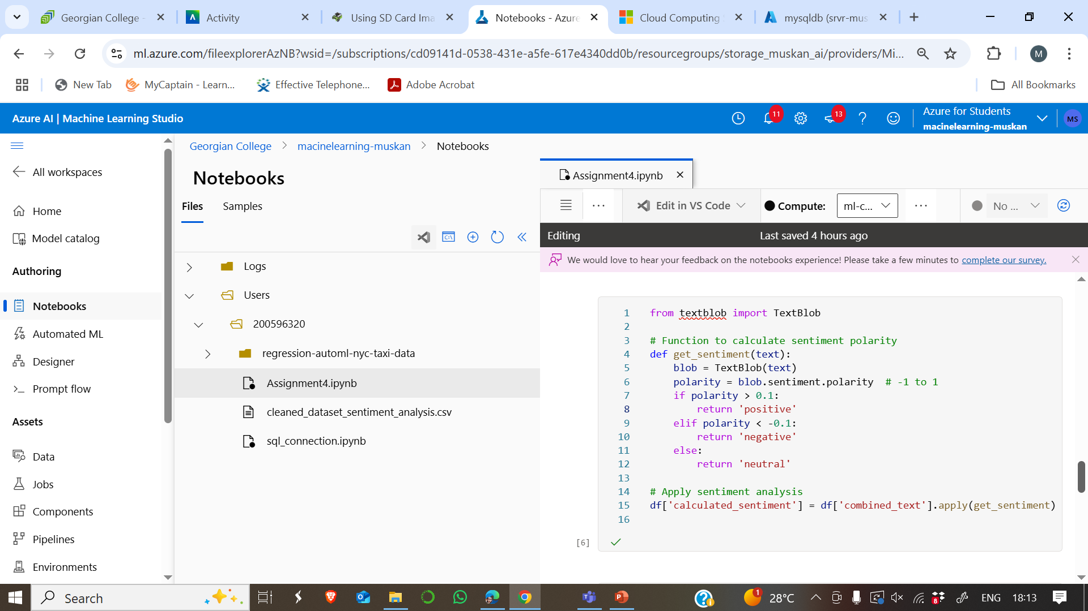
Step 4-Sentiment Analysis Using TextBlob
Goal: Calculate sentiment polarity for each news article and classify as Positive, Negative, or Neutral.
Code Steps:
Function get_sentiment(text):
Uses TextBlob to calculate polarity (range: -1 to 1).
Classification Logic:
Polarity > 0.1 → Positive
Polarity < -0.1 → Negative
Otherwise → Neutral
Applied Function: df['calculated_sentiment'] = df['combined_text'].apply(get_sentiment)
Insights:
Majority of positive labels matched (1447).
Some misclassifications due to polarity threshold sensitivity.
Neutral cases had more variance (e.g., Positive → Neutral).

Slide 8
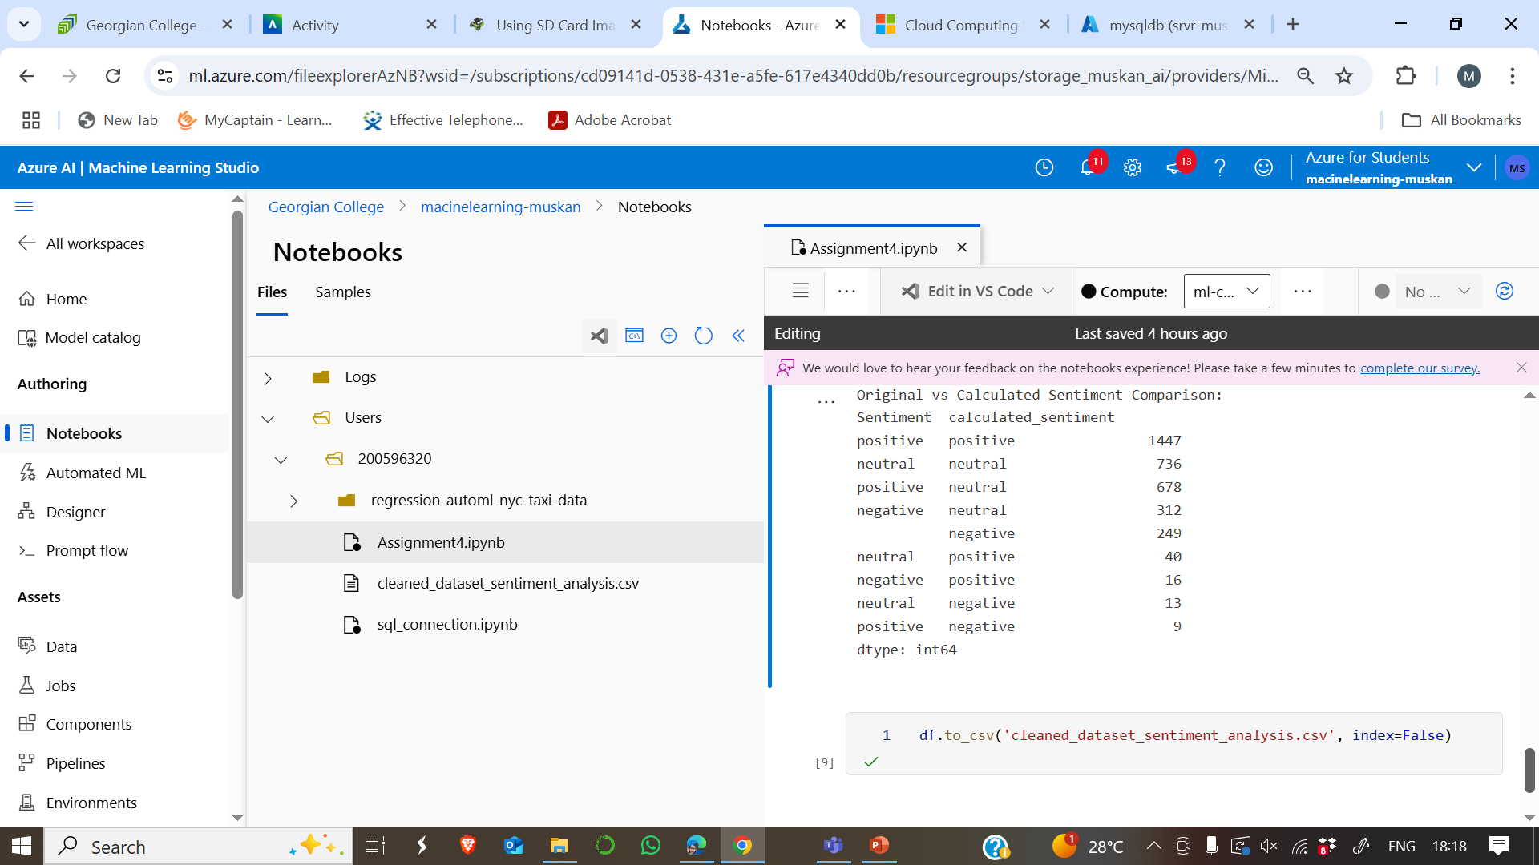
Step 5- Exporting Cleaned Dataset for PowerBI
After preprocessing and applying sentiment analysis in Python:
Removed nulls, duplicates, and unnecessary columns.
Created a final DataFrame with news text, calculated sentiment, original sentiment, category, and source.
Exported to CSV:
python
df.to_csv('cleaned_news_sentiment.csv', index=False)

Slide 9
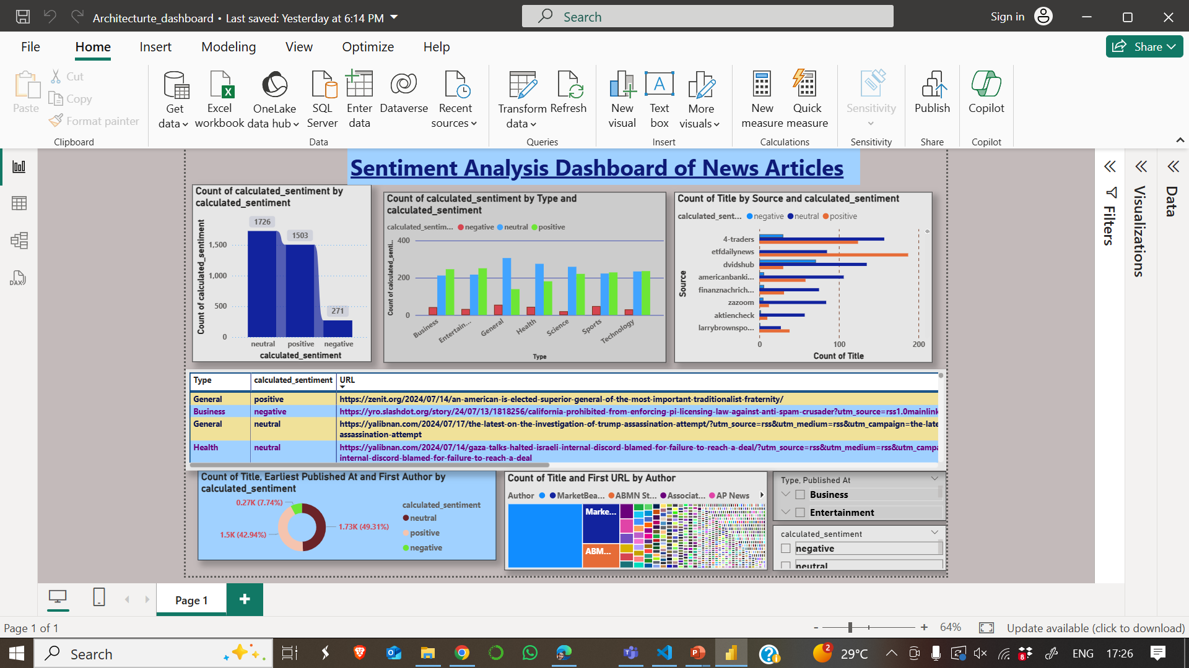
Sentiment Analysis Dashboard – News Articles

Slide 10

Dashboard Insights
The dashboard provides insights into the sentiment of news articles across various dimensions:
Bar Chart (Top-Left)
Shows the distribution of sentiments:
Neutral (~1726), Positive (~1503), Negative (~271).
Indicates most news articles are neutral.
Bar Chart (Top-Middle)
Sentiment by News Type (e.g., Business, Health, Sports).
Positive and neutral dominate across most categories.
Bar Chart (Top-Right)
Sentiment by Source: Displays which sources publish more positive/negative content.
Table (Center)
Lists article type, sentiment, and URL for quick reference.
Donut Chart (Bottom-Left)
Shows sentiment distribution percentage (Positive ~49%, Neutral ~43%, Negative ~7%).
Tree Map (Bottom-Right)
Displays article count by author for contribution analysis.

Slide 11
GitHub Link for the Assignment
GitHub - Muskan-coder719/Sentiment_Analysis_Assignment4

Slide 12

THANK YOU!

